Slide 1
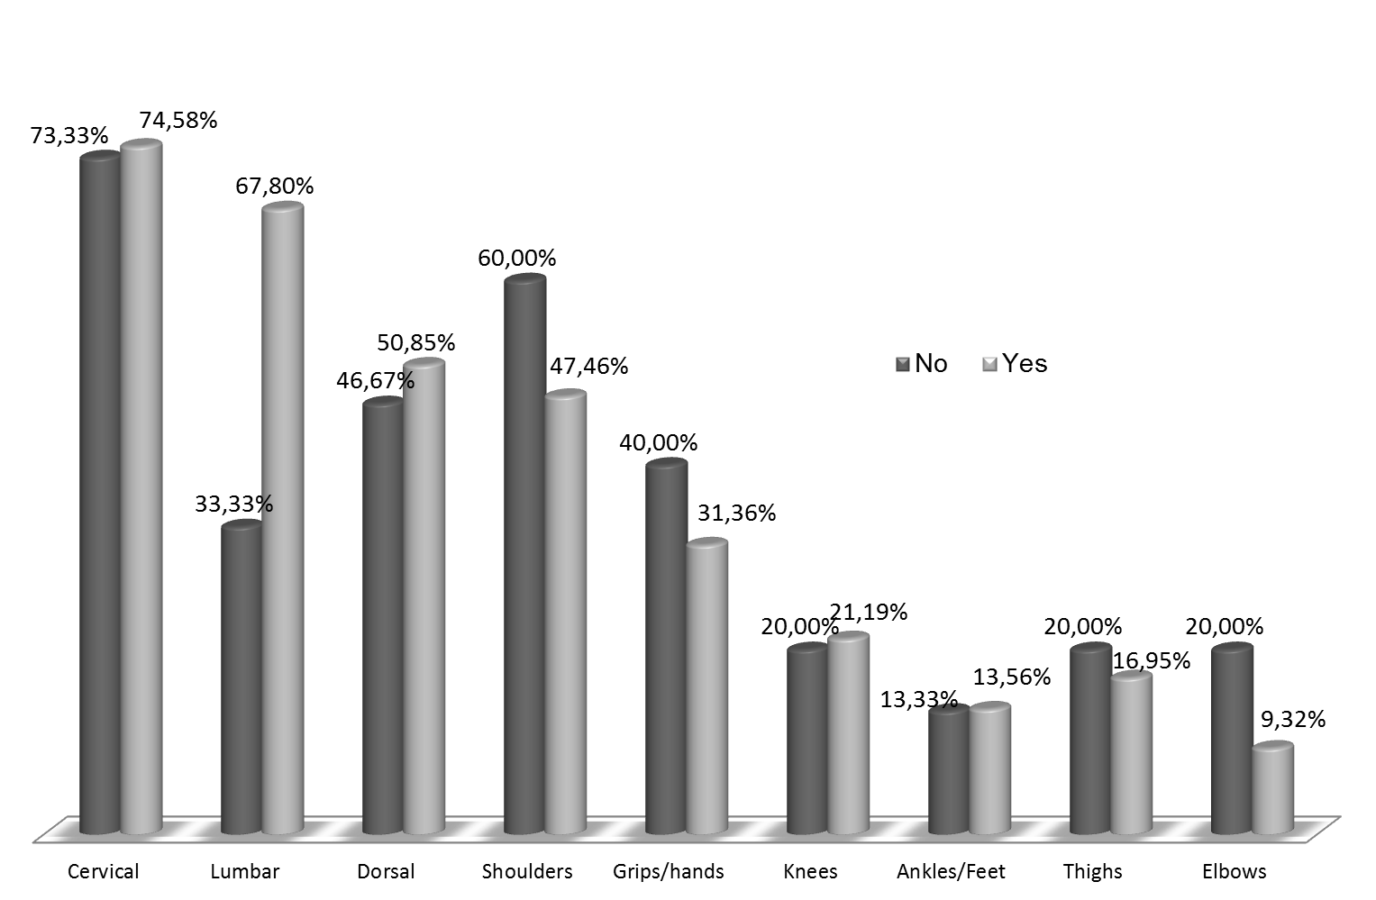
Paper # (Gill Sans MT Font 40)
Title of the poster in Text Gill Sans MT Font 44 Title of the poster in Text Gill Sans MT Font 44Title of the poster in Text Gill Sans MT Font 44 Title of the poster in Text Gill Sans MT Font
John Name1ª, Jane Name2^{b} & John Name3ª
ª Department of Production, University of the World
^{b} Home of Department, USA
introduction (Text Gill Sans font 40)
Text Gill Sans font 32
Characterization and evaluation of musculoskeletal complaints in nurses who provide home-based care and belong to Health Centres of northern Portugal
materials and method (Text Gill Sans font 40)
Text Gill Sans font 32
Characterization and evaluation of musculoskeletal complaints in nurses who provide home-based care and belong to Health Centres of northern Portugal
Figure 1 – Text Gill Sans font 28
results and discussion (Text Gill Sans font 40)
Text Gill Sans font 32
Characterization and evaluation of musculoskeletal complaints in nurses who provide home-based care and belong to Health Centres of northern Portugal
conclusions (Text Gill Sans font 40)
Text Gill Sans font 32
Characterization and evaluation of musculoskeletal complaints in nurses who provide home-based care and belong to Health Centres of northern Portugal

