Slide 1
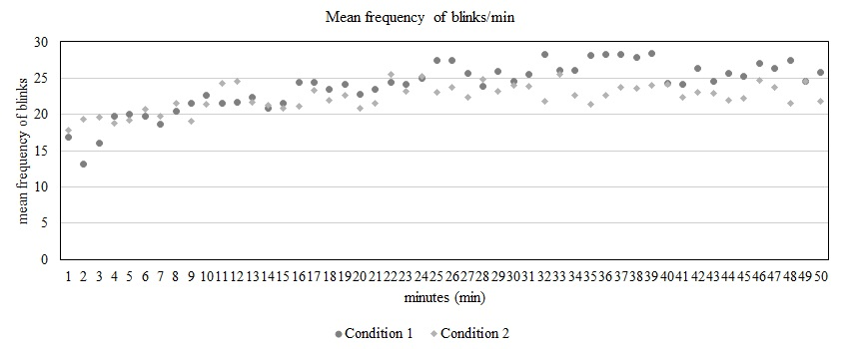
Paper ##
Title in English
A. B. Casaª & C. D. Sol^{b}
ª Laboratory of Something, Faculty of Something, University of Somewhere, Country
^{b} Research Center on Something, Faculty of Something, University of Somewhere, Country
Introduction
M nn nl nl nl nkjbj bk ml jnk nlk mljk bjhb gvgdxfsdzfdh ggv kjnk jnkjnkjb jhvjh ghbkjnkjbjvj hbjhbj hbj vj hj v
Khb kjn khbkj bnkhbk jbhjvh gkjbjvjhvk jbk hvk jbjk hb
hbjhb.
icates k k k lk mlk nlkn lkn lkn lknl knl knl knl k kijiyguty ytf trdy tu jnk mk m kl r werg wergw erfagyliç çjçjç h ik jk bjhb gvgdxfsdzfdh ggv kjnk jnkjnkjb jhvjh ghbkjnkjbjvj hbjhbj hbj vj hj v
Hjkfjhds kkksdf dfafg arye kasjd poiuqr asfhakjhfs qpwir
Khb kjn khbkj bnkhbk jbhjvh gkjbjvjhvk jbk hvk jbjk hb
hbjhb. M nn nl nl nl nkjbj bk ml jnk nlk mljk bjhb gvgdxfsdzfdh ggv kjnk jnkjnkjb jhvjh ghbkjnkjbjvj hbjhbj hbj vj hj v.
Khb kjn khbkj bnkhbk jbhjvh gkjbjvjhvk jbk hvk jbjk hb.
Materials and Method
njnjnkjnkjnkj suh uish uh oifjh oifjh oifj oij oifjh oifjh oif voifj voidjf voijv odijodijv dv jnd jsdnc sjdhc skjd csd cos dcos dosdc so
in a jnjnjnkjnkjnkj suh uish uh oifjh oifjh oifj oij oifjh oifjh oif voifj voidjf voijv odijodijv dv jnd jsdnc sjdhc skjd csd cos dcos dosdc so
in a jnjnjnkjnkjnkj suh uish uh oifjh oifjh oifj oij oifjh oifjh oif voifj voidjf voijv odijodijv dv jnd jsdnc sjdhc skjd csd cos dcos dosdc so
Oij ioj oijoij iodh uidh iuh iuh iuh iwuh iwudh iwuhiwudh iwuh iwuh
Oij ioj oijoij iodh uidh iuh iuh iuh iwuh iwudh iwuhiwudh iwuh iwuh iwu h.
Results and Discussion
sudhosjv osiujhv ojhv ojh vosi jvosijo
kijiyguty ytf trdy tu jnk mk m kl r werg wergw erfagyliç çjçjç h ik fyh rg kj j nlkn ljnl knl knkj bk jlkn lkm lkml nl kmlk nl kl m
M nn nl nl nl nkjbj bk ml jnk nlk mljk bjhb gvgdxfsdzfdh ggv kjnk jnkjnkjb jhvjh ghbkjnkjbjvj hbjhbj hbj vj hj v
Khb kjn khbkj bnkhbk jbhjvh gkjbjvjhvk jbk hvk jbjk hb
hbjhb asfwer.
kijiyguty ytf trdy tu jnk mk m kl r werg wergw erfagyliç çjçjç h ik fyh rg kj j nlkn ljnl knl knkj bk jlkn lkm lkml nl kmlk nl kl m
M nn nl nl nl nkjbj bk ml jnk nlk mljk bjhb gvgdxfsdzfdh ggv kjnk jnkjnkjb jhvjh ghbkjnkjbjvj hbjhbj hbj vj hj v
Khb kjn khbkj bnkhbk jbhjvh gkjbjvjhvk jbk hvk jbjk hb
hbjhb.
Figure 1 – Conditions 1 and 2: mean frequency
Conclusions
kijiyguty ytf trdy tu jnk mk m kl r werg wergw erfagyliç çjçjç h ik fyh rg kj j nlkn ljnl knl knkj bk jlkn lkm lkml nl kmlk nl kl m
M nn nl nl nl nkjbj bk ml jnk nlk mljk bjhb gvgdxfsdzfdh ggv kjnk jnkjnkjb jhvjh ghbkjnkjbjvj hbjhbj hbj vj hj v
Khb kjn khbkj bnkhbk jbhjvh gkjbjvjhvk jbk hvk jbjk hb
hbjhb.
kijiyguty ytf trdy tu jnk mk m kl r werg wergw erfagyliç çjçjç h ik fyh rg kj j nlkn ljnl knl knkj bk jlkn lkm lkml nl kmlk nl kl m.

